Slide 1
Piskadera Project Presentation
A Unified Vision for Luxury and Sustainability in Curaçao

Slide 2
Project Overview
The Piskadera Project is a premier luxury destination combining high-end residences, tourism, and recreation. It embodies sustainability, modern architecture, and a connection to nature, creating a unique experience for residents and visitors.

Slide 3
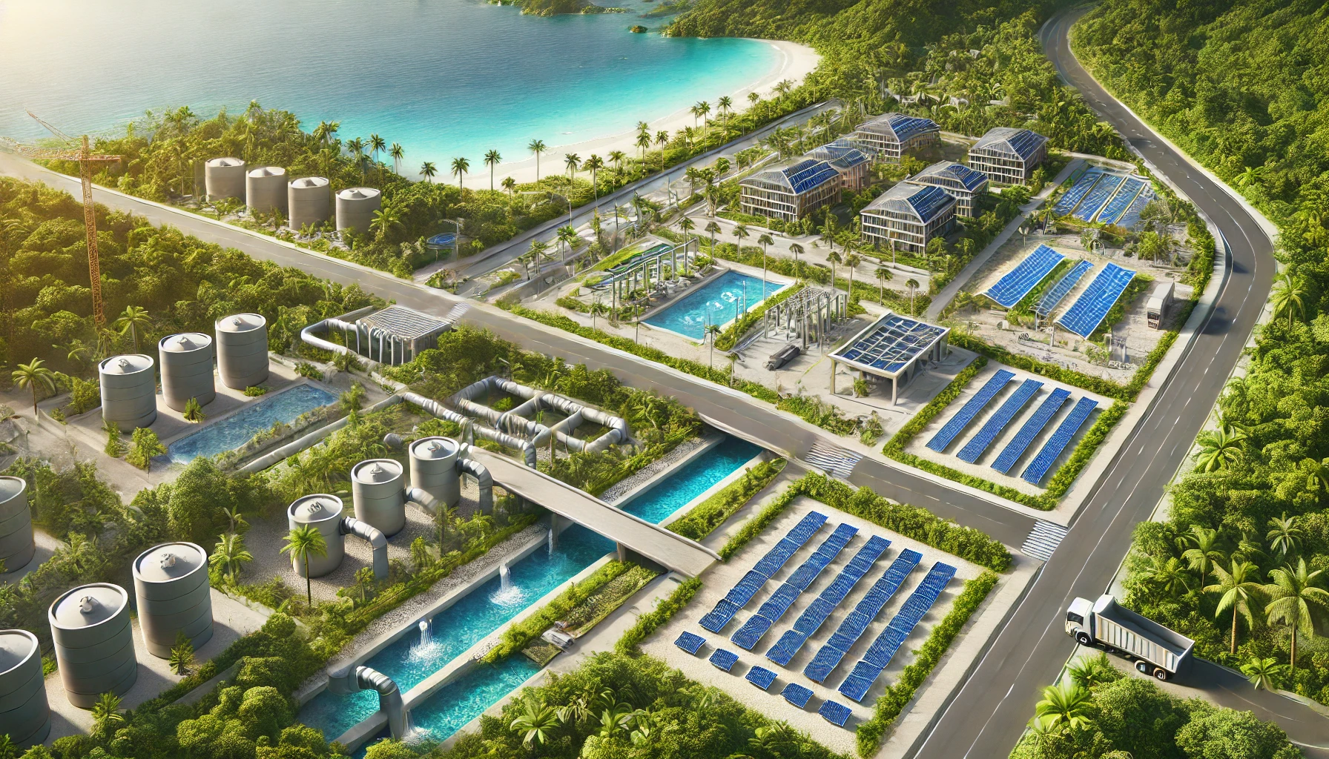
Sector 1: Infrastructure and Utilities
This sector ensures the foundation for Piskadera’s operations:
- Construction of roads and sustainable utility systems.
- Implementation of solar energy panels and water recycling facilities.
- Efficient zoning for future scalability.

Slide 4
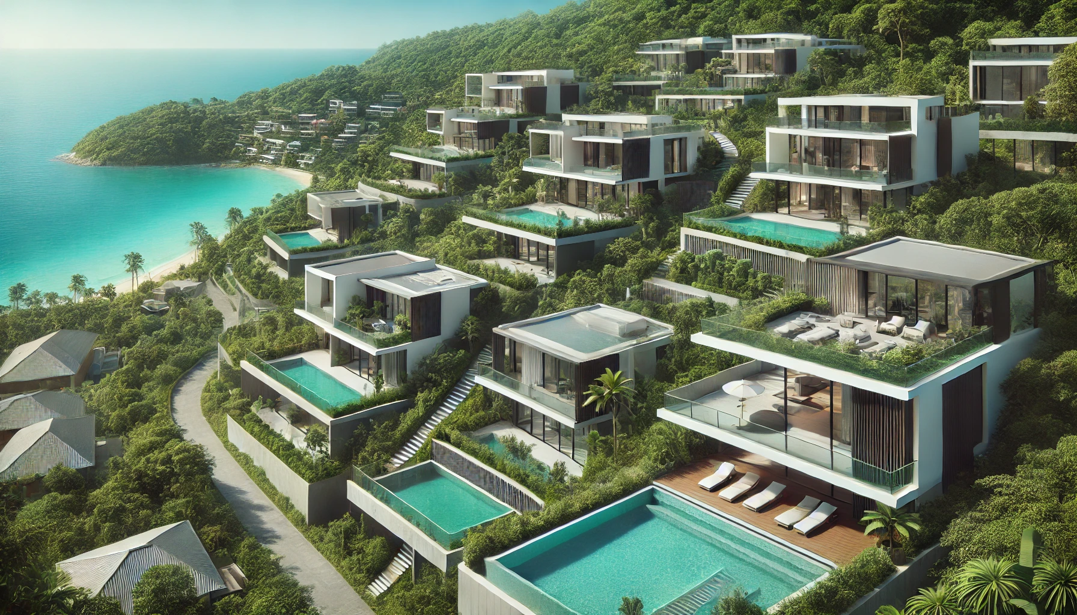
Sector 2: Residential Development
The luxury hillside villas and apartments are designed to merge elegance with sustainability:
- Sleek modern architecture with large windows for panoramic ocean views.
- Eco-friendly materials and smart home technology.
- Private gardens, infinity pools, and community amenities.

Slide 5
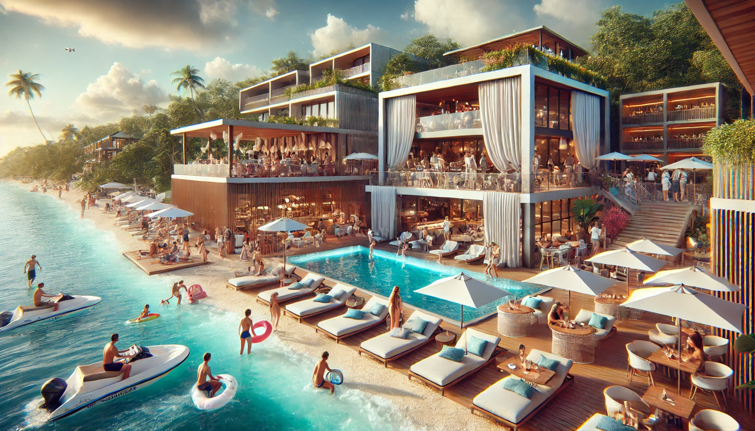
Sector 3: Beach Club and Hospitality
This sector combines vibrant social spaces with relaxation:
- A fully operational beach club featuring cabanas, a poolside bar, and water sports rentals.
- A boutique hotel offering luxury accommodations, a casino, and a fine dining restaurant.

Slide 6
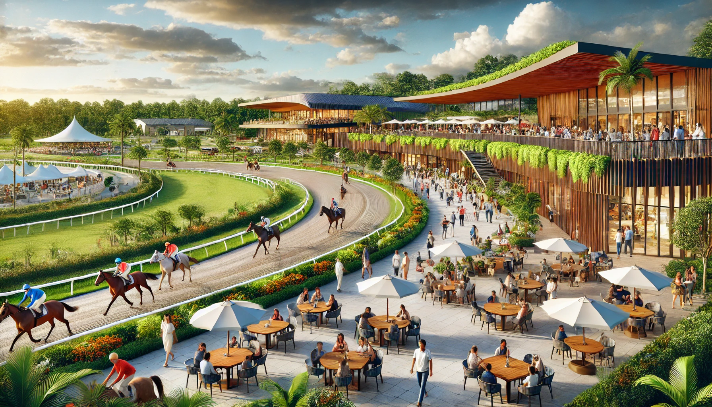
Sector 4: Recreational and Commercial Spaces
A hub for leisure and economic activity:
- Modern horse racing park with spectator seating and stables.
- Botanical gardens and hiking trails for eco-tourism.
- High-end shopping districts and gourmet dining.

